Slide 1
Lets Get Connected
Containerising Android messaging application and launching it using Automation by Ansible on Hybrid cloud

Slide 2
Submitted by:
Nishan Acharya 1705247
Subham Char 1705277
Pritam Ghosh 1705427

Slide 3
Introduction
Nowadays messaging applications are vastly used in sharing of useful information, from staying connected to our closed ones to get to know about new people, and so on.
Our application Lets Get Connected, provides encryption and decryption of messages to protect the user from unauthorized access and disclosure of messages over networks.We are using cryptography vault concept to protect the messages from unauthorized access and disclosure and Hybrid Cloud which provides resources to create 2 subnets one private and another public subnet connected to each other via VPN with a bastion host which acts as an dummy host the between the two subnets for the process of communication and will help in making our Application to undergo faster deployment, scalability undergoing replication and henceforth reduces latency and prevents our application from getting freezed and creates a secured enviorment for proper workflow, maintainance between the client and the administrator.

Slide 4
Aims & Objectives
If we list out aims and objectives of our project then they can be listed as :
Provide and end-to-end sender-receiver message delivery application.
Provide a platform for secure and encrypted messaging.
Provides Better Load Balancing, Scalability.
Provides Faster Deployment.
Restricts to minimum Latency from Client Side.
Provides better efficiency and maintainance due to the use of Automation.
Provides Persistant Storage Capability.
Provides maintainance services directly over the Cloud with one Click and one touch Function all across the world wide web.
Provides Taint and Tolerance to our Application.
Follows all the Data Protection Policy to prevent the data from being hacked by any means.
Provide the user an user-friendly interface and allow them to change profile picture.

Slide 5
Software Requirements
User Registration
Existing User Login
Adding new people to chat window
View user online/offline status
Send and receive messages
Maintain user privacy
Change Profile Picture

Slide 6
Basic Concepts
Android Studio :
Android Studio is the IDE for Android Application development. It is built on IntelliJ IDEA software and incorporates its code editing and development tools. It uses a Gradle-based build system, emulator, code templates, Github integration, Firebase integration etc. The code editor also offers code completion, refraction and analysis.
In our project Android Gradle version 6.5 is used. And we used Java 8.0 as backend programming language.

Slide 7
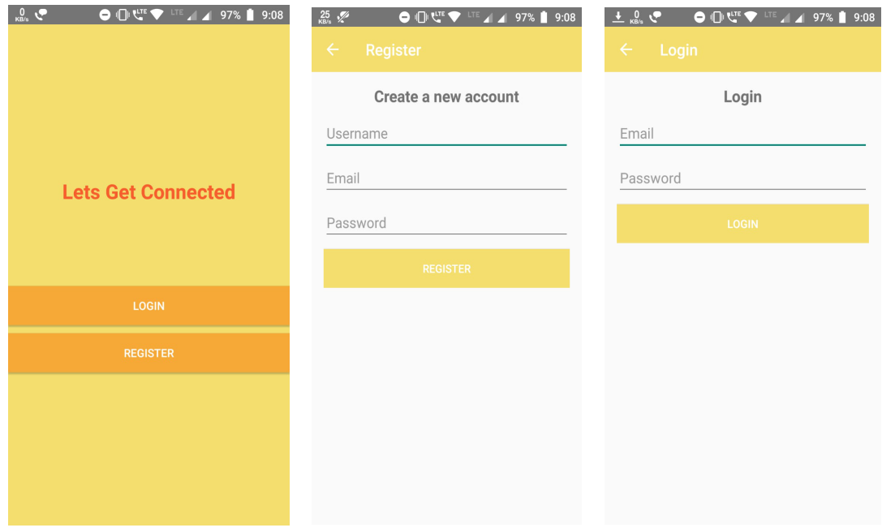
Android Activities

Slide 8
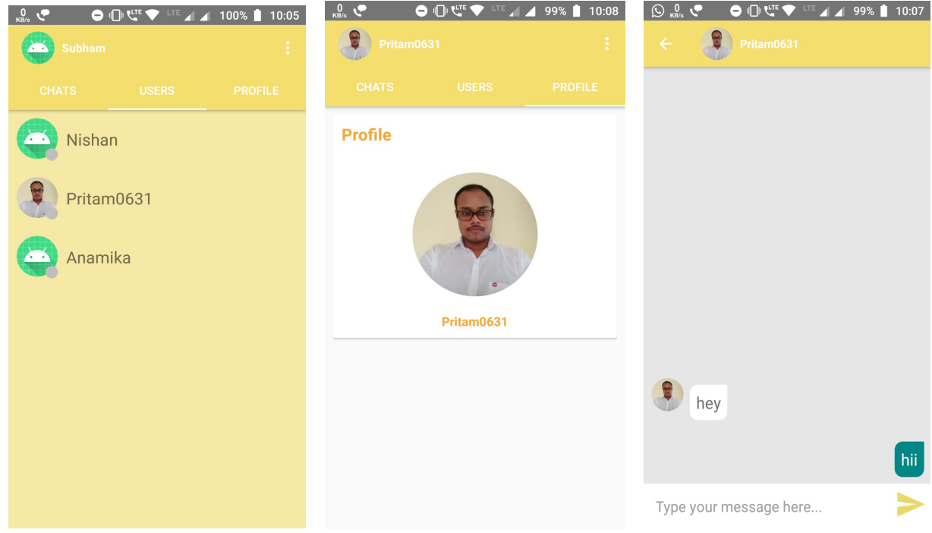
Android Activities

Slide 9
Firebase :
Google Firebase is a BaaS service. It provides developers with a variety of tools and services to help them develop high quality apps and include multiple features in them. Firebase is a NoSQL database program. It stores data in JSON format.
Ansible :
Ansible is a powerful directory management tool that provides automation and has the capability to send and receive messages to and from a corresponding device over any distance with zero latency.

Slide 10
We used Ansible in our project where :
Automating the Deployment of of our Lets Get Connected by First Integrating Ansible with AWS Cloud.
We Launch an AWS instance with the help of ansible, In creation of Ansible vault passage.
Retrieve the public IP which is allocated to the launched instance. With the help of the retrieved Public IP configure the Cloned in the launched instance.
Creation of HAProxy that helped in containerising our application.

Slide 11
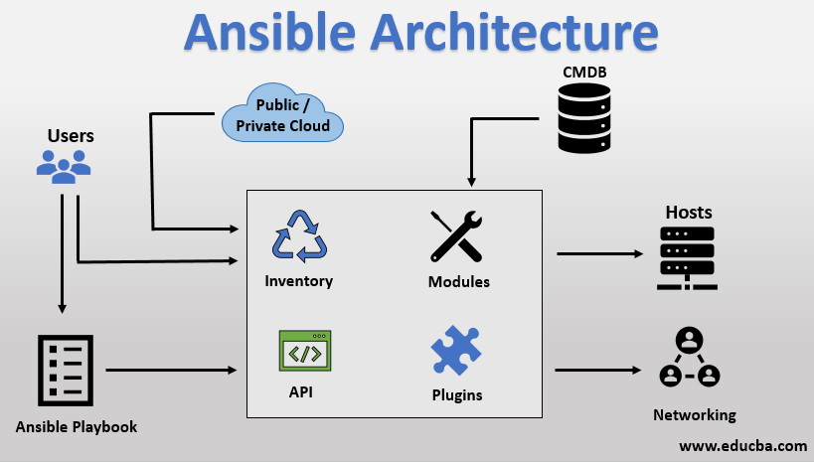

Slide 12
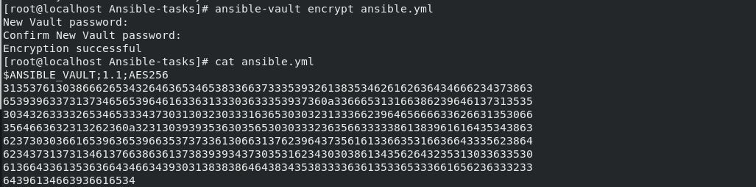
Cryptography Vault :
Cryptography vault is a feature of Ansible that provides the capability to provide 215 bit encryption to our file which can’t ever be decoded by a human except the admin. For decryption it needs a private key which is created by the admin itself during the time of creation.
Apart from securing user data, it completely secures our modules and IaaS, PaaS modules.

Slide 13
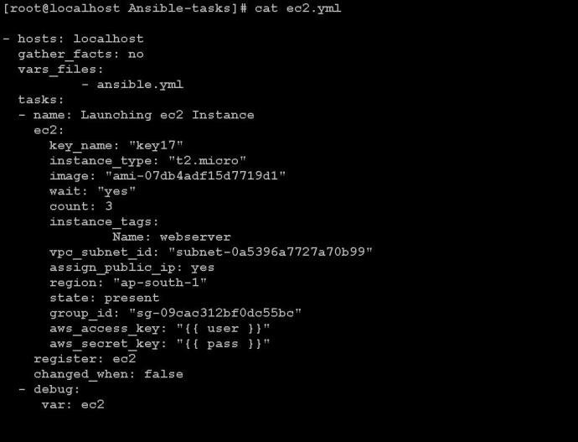
Here we launched 3 AWS instances from Ansible using playbook with a public key assigned through the IAM user from AWS and created an instance of type t2.micro and Amazon AMI linux image in the VPC region Mumbai, having an access key and a secret key for vault passage which are accessed through a variable cased file ansible.yml

Slide 14
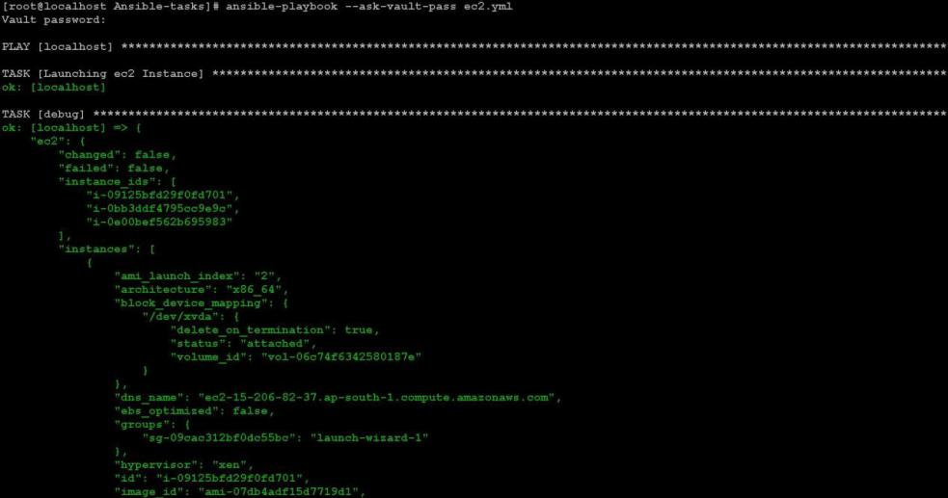
Playbook Execution through Vault

Slide 15
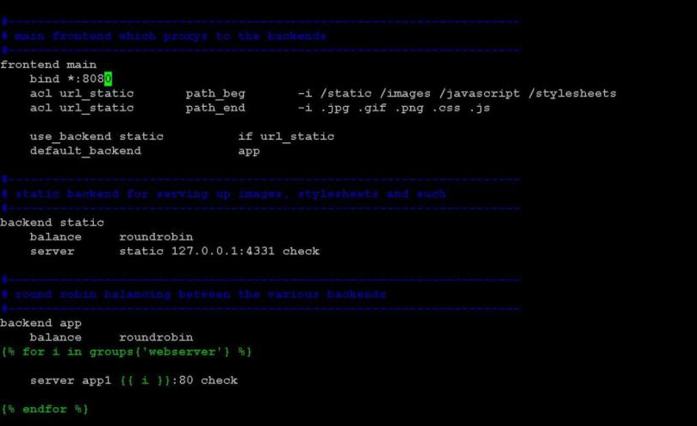
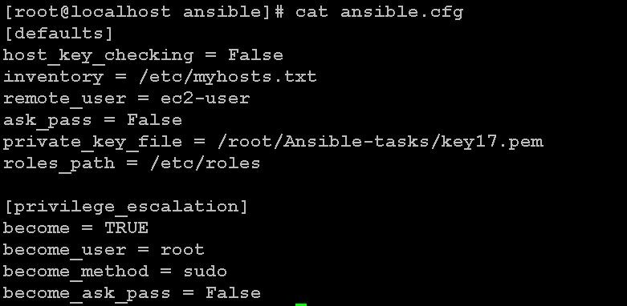
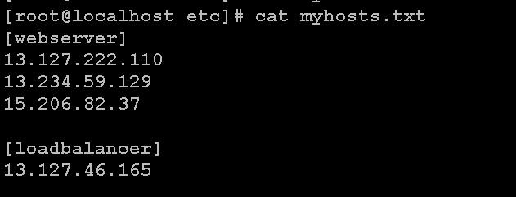
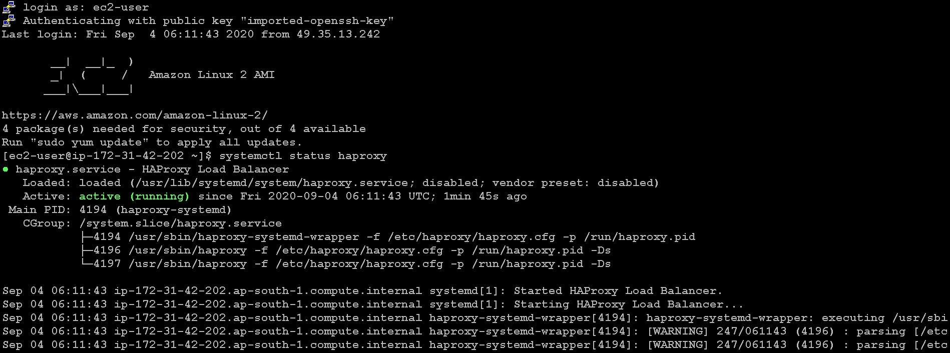
Creating Role for HAProxy handler :

Slide 16
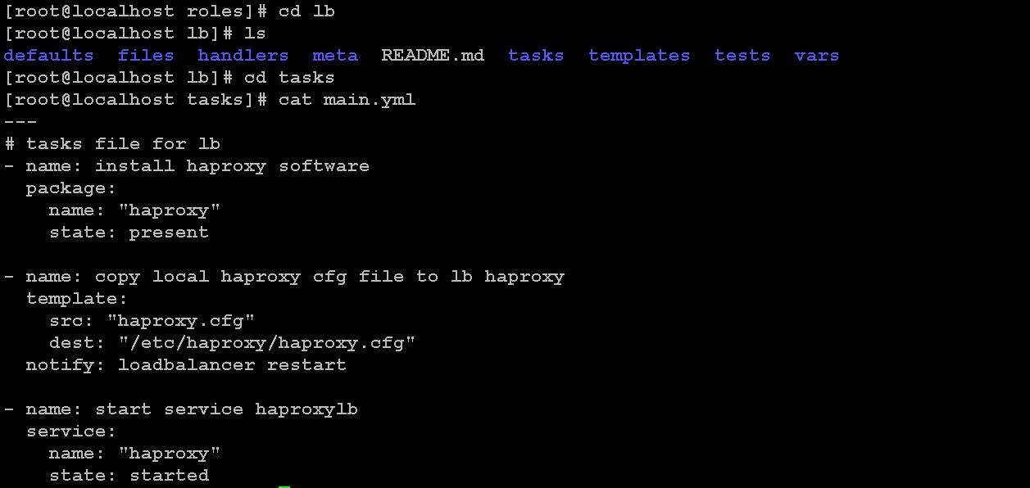
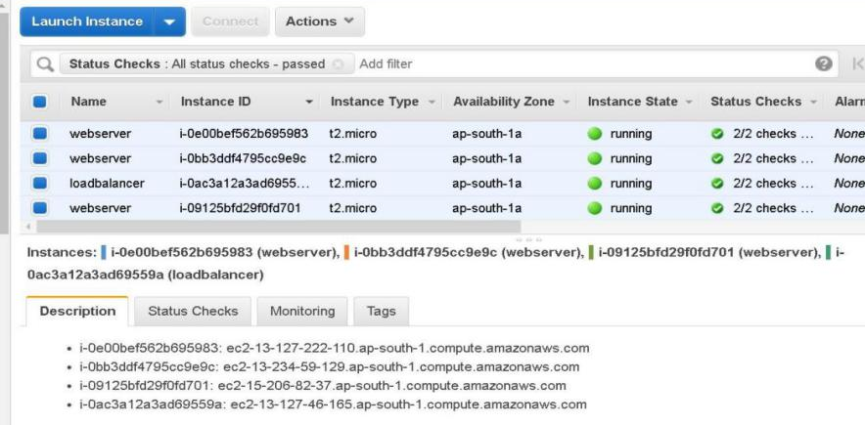
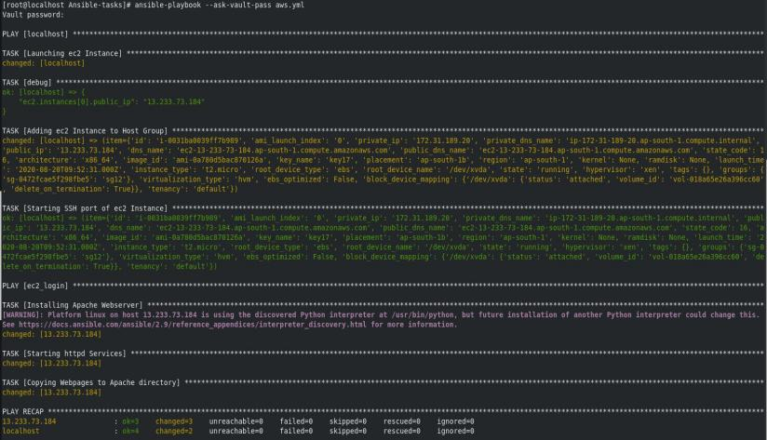
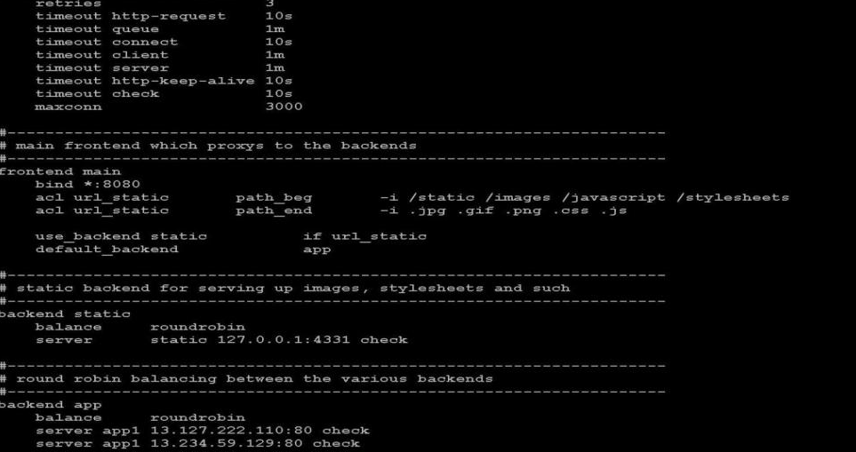

Slide 17
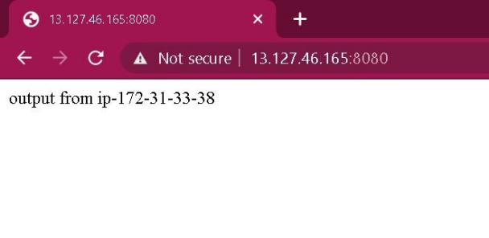
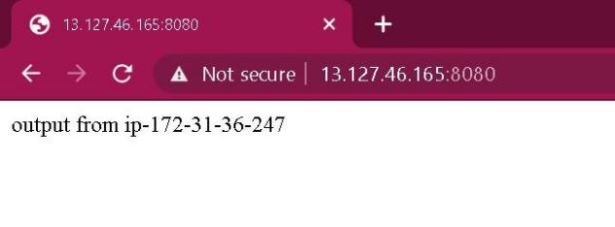
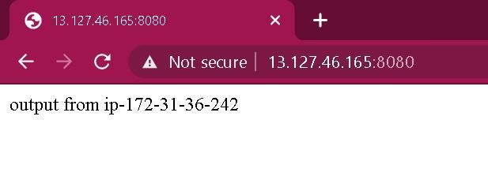
Fig:Random IP generated by HAProxy for managing our application

Slide 18
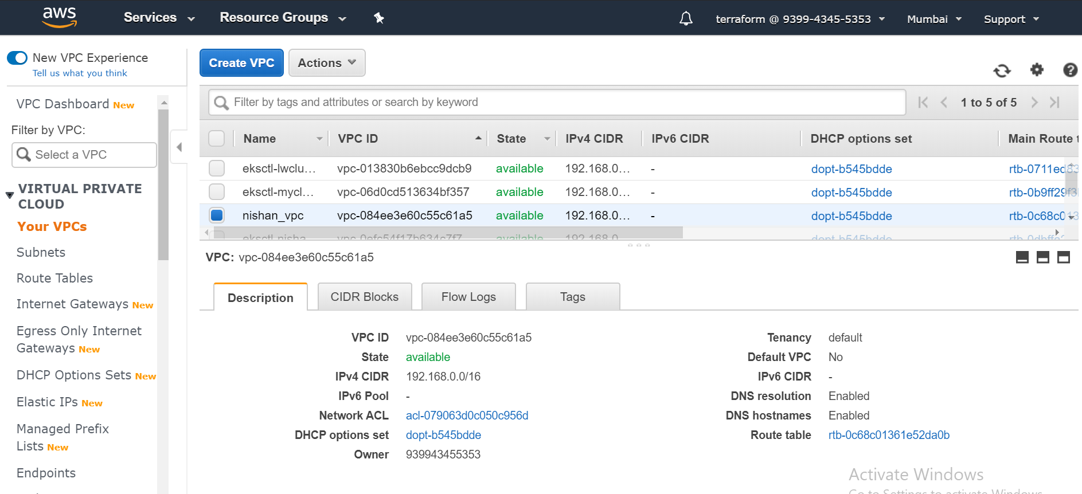
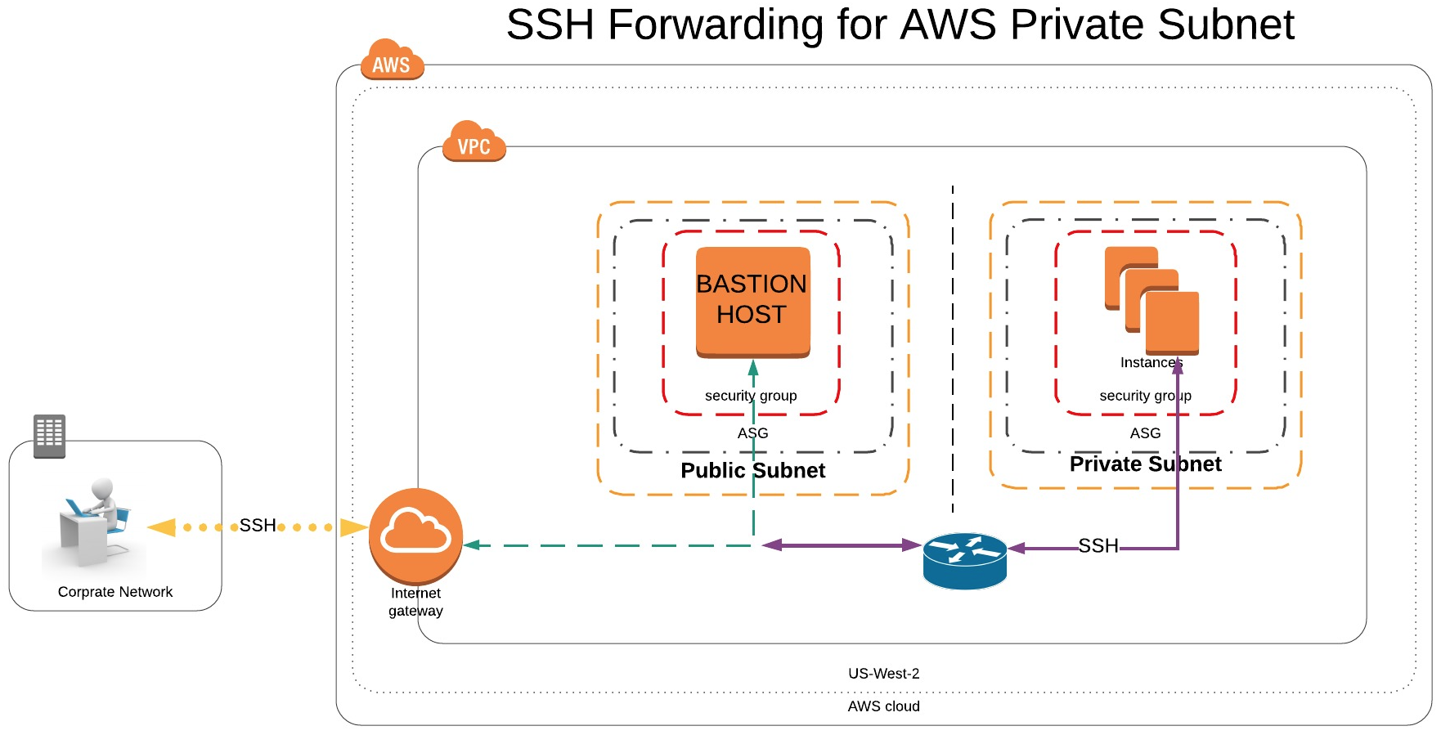
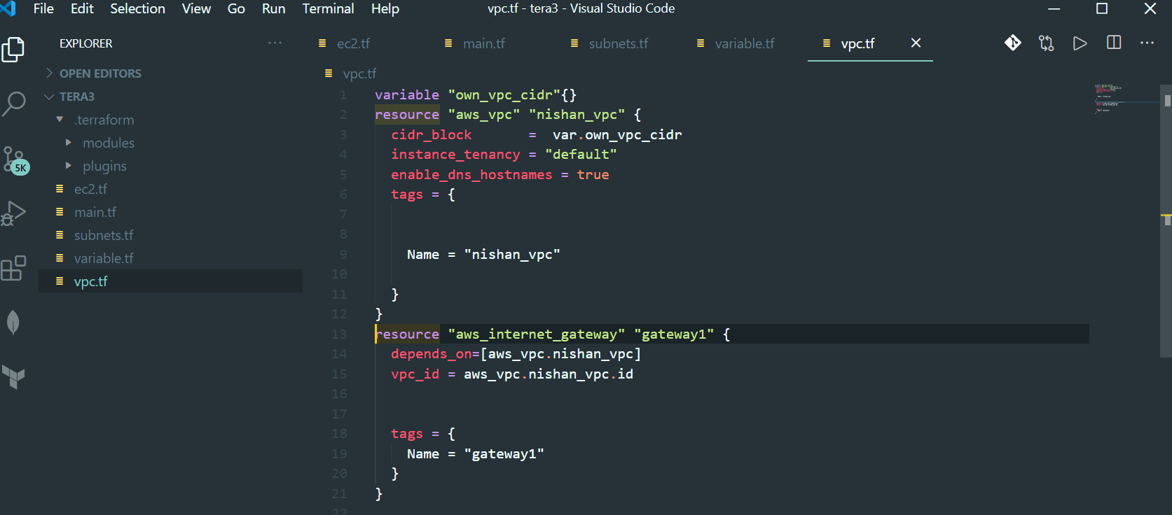

Subnet creation on Cloud with a Bastion Host
AWS Profile Creation
VPC Creation

Slide 19
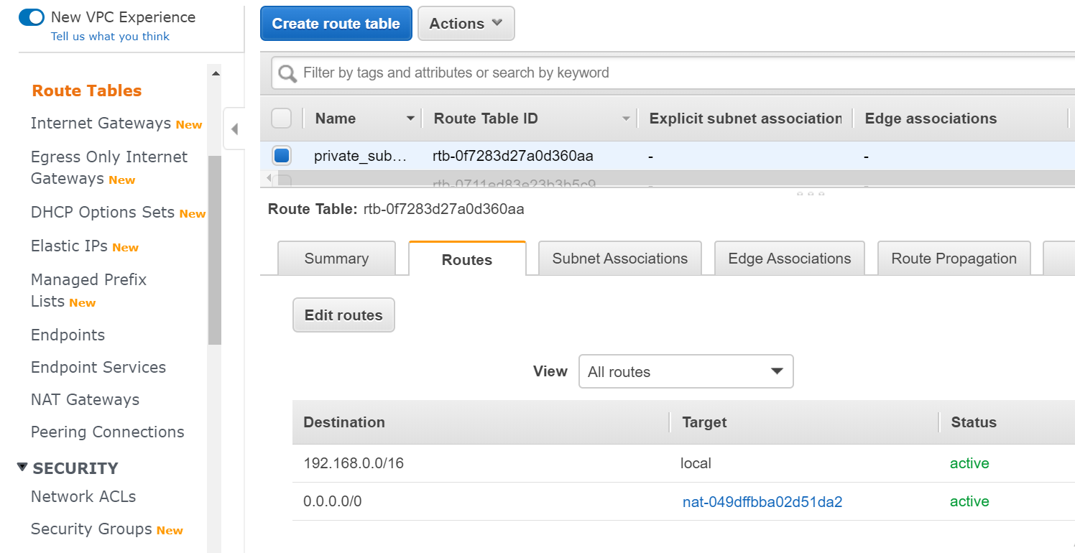
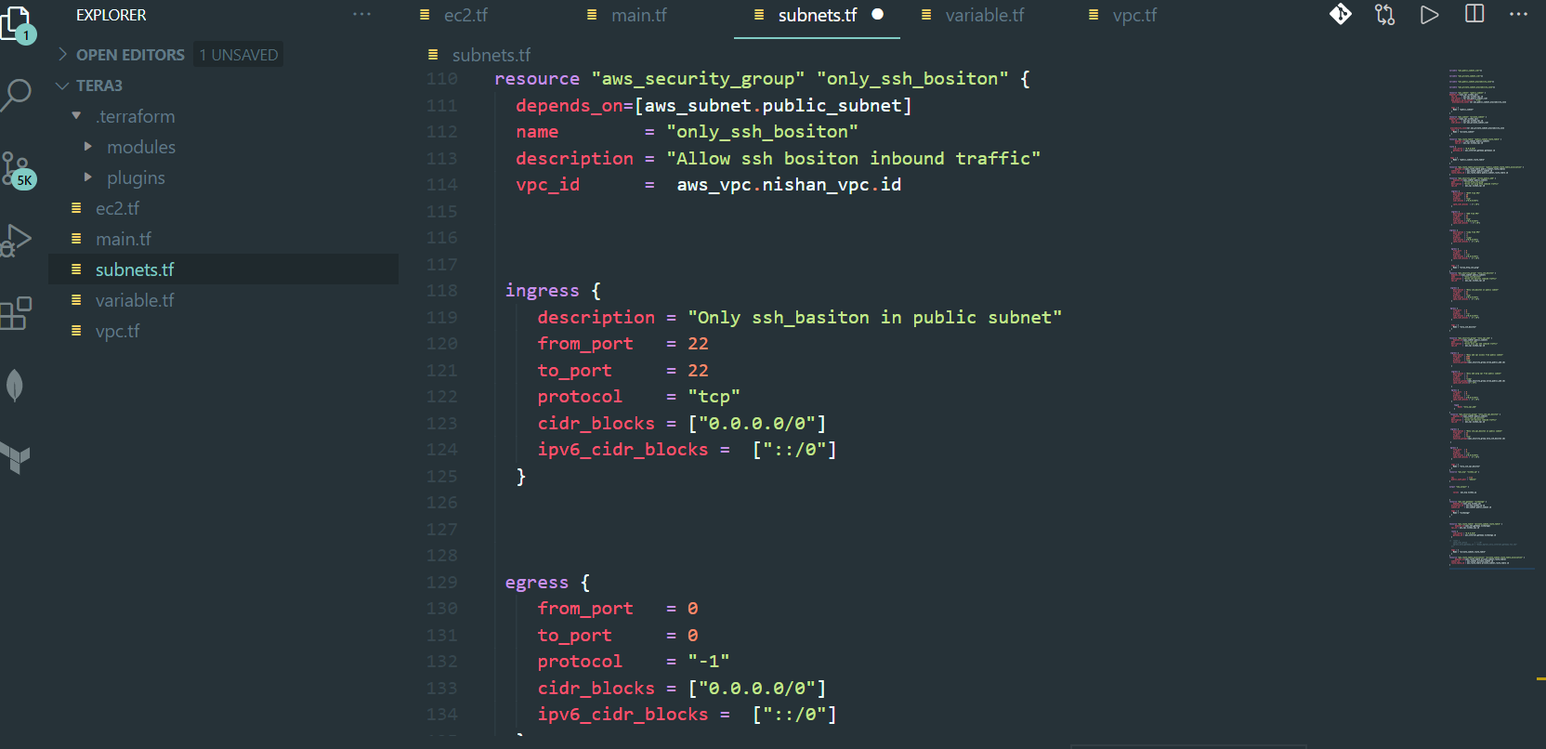
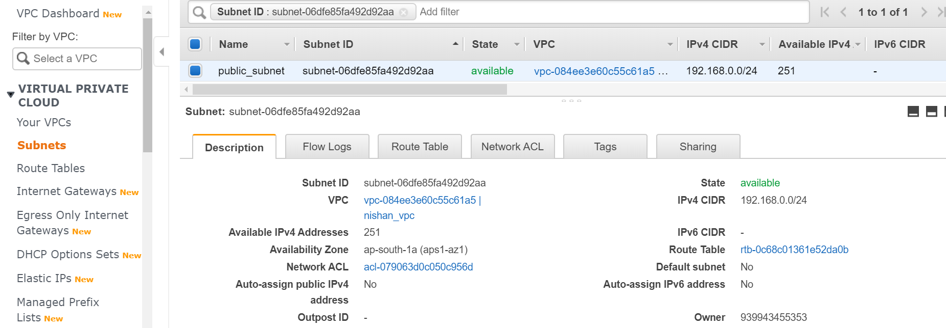
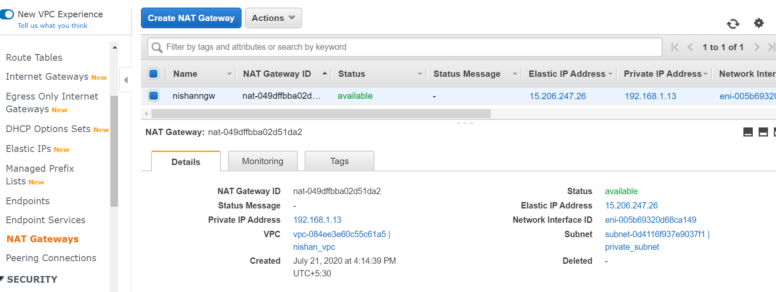
Setting up subnet
Rout table
Subnet creation
NAT gateway

Slide 20
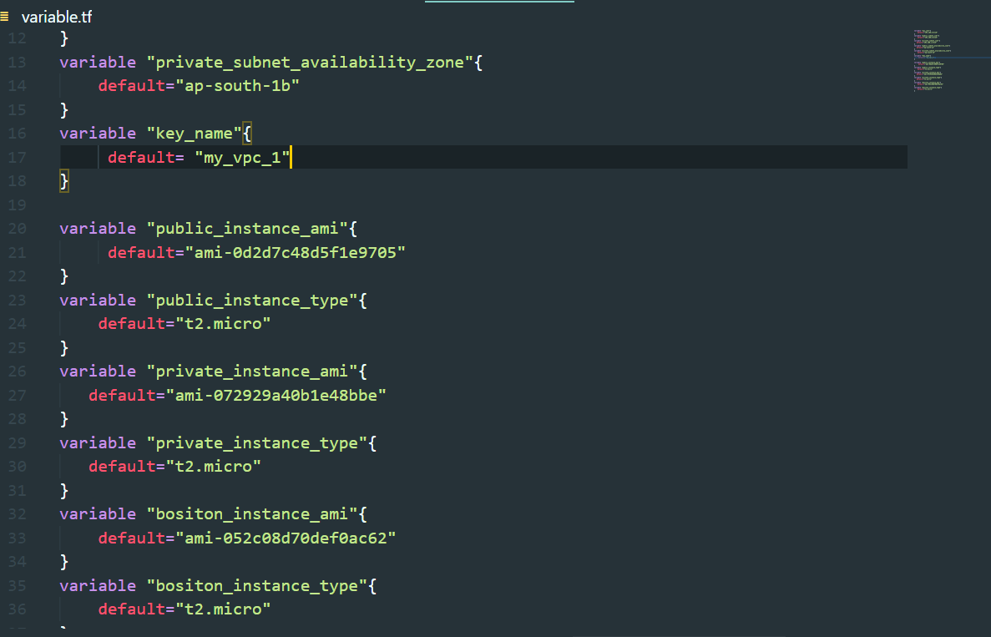
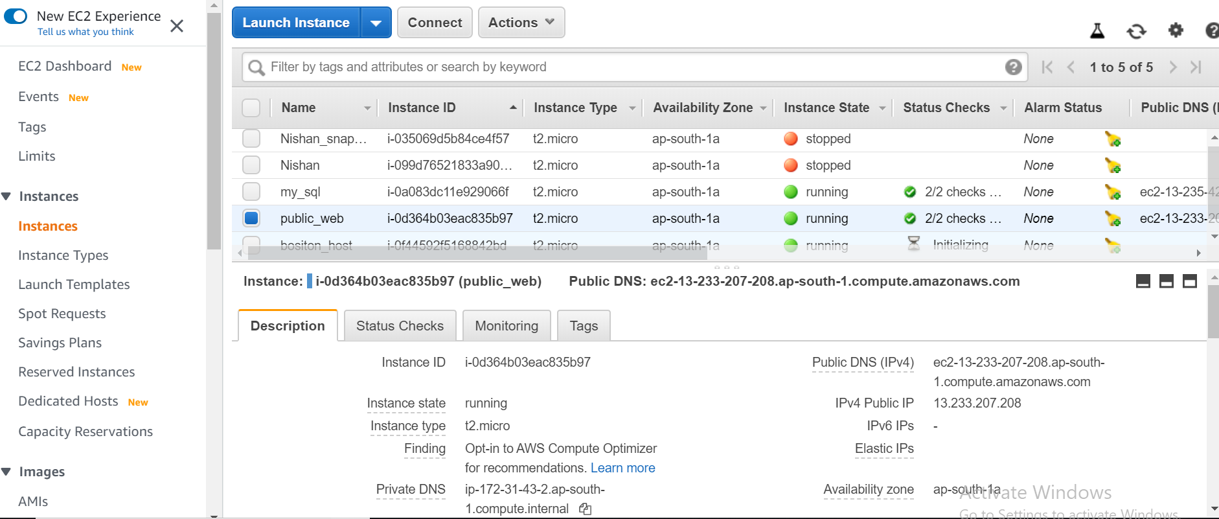
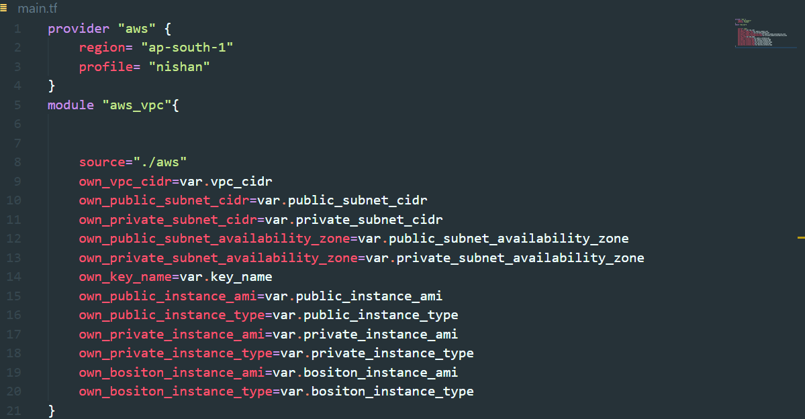
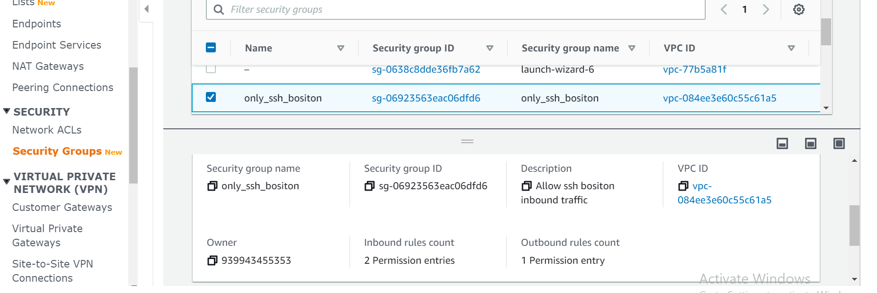
Bastion host instances
Bastion host firewall

Slide 21
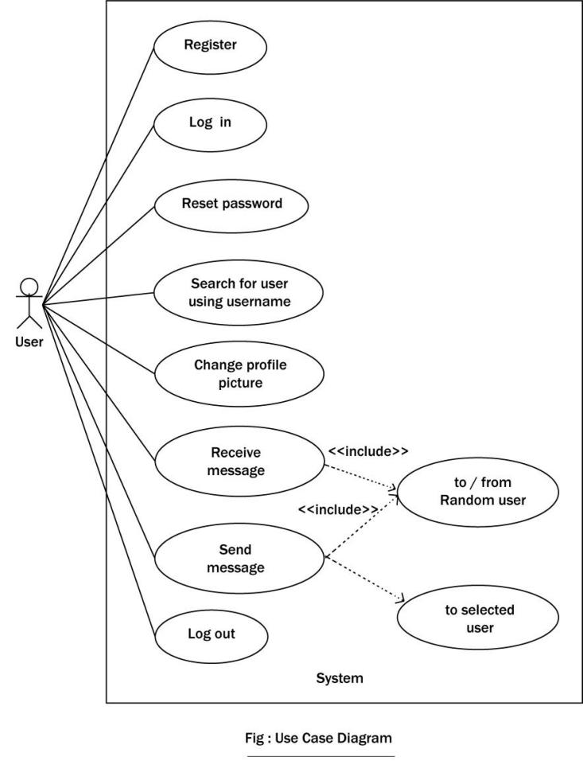
Use Case Diagram

Slide 22
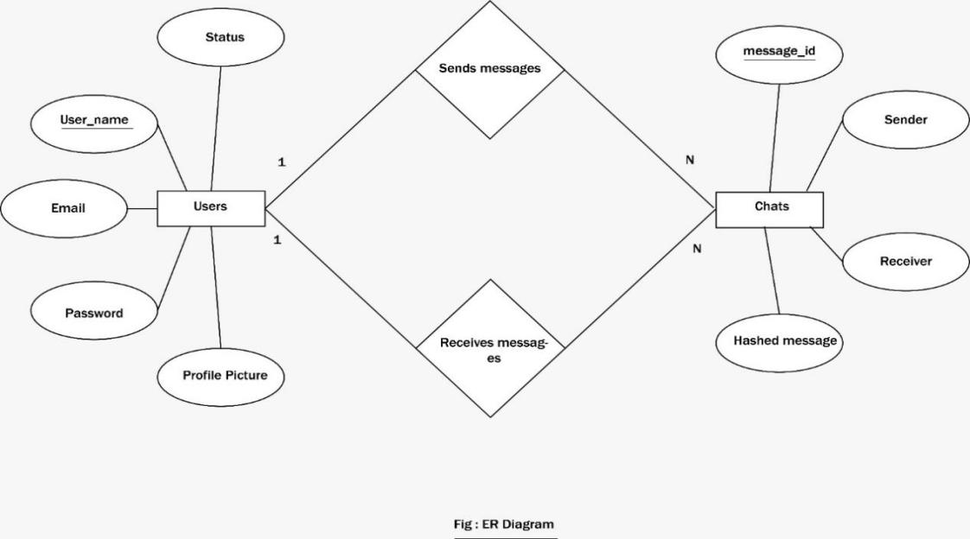
Entity Relationship Diagram

Slide 23
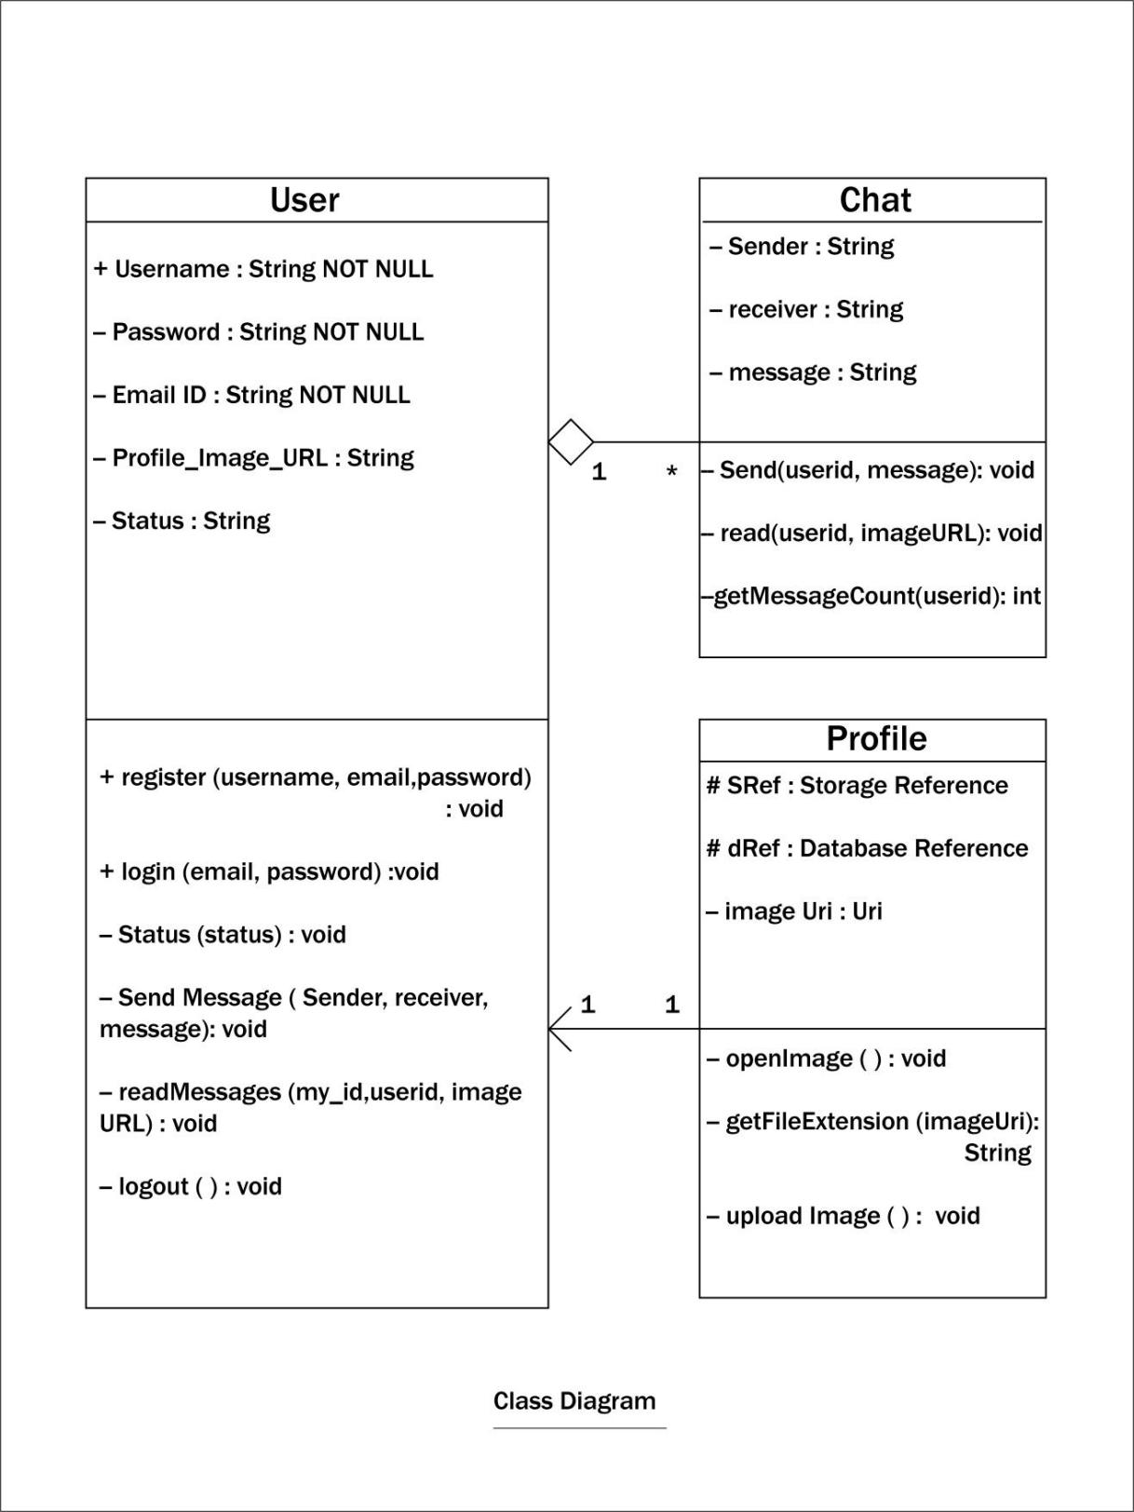
Class Diagram

Slide 24
Future Work
There is always a room for improvement in any android application. We are currently working on enhancing the User Interface (UI) and User Experience. Also right now we are dealing with text communication only. In future we are planning on adding features like sharing of images, videos or any other files, voice message, video message, audio calling, video calling, group calling, and so on.

Slide 25
Conclusion
After having concluded our project and application development, we found a simple, hassle-free, reliable, secured and fast messaging application ready to be delivered to its users. User privacy and security is perfectly maintained in the application. While doing the project we got to learn about different methods of cryptography and we used hash functions to encrypt the messages interchanged between two users before storing them to Firebase database. We are constantly working on improving our application, meet user requirements from time to time and pushing it further up on trending messaging application list.

